Slide 1

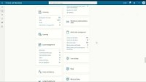
TECHNOLOGY UNIFICATION
Embed Resources as Standard Workspaces
Adding a Website as a Workspace
Incorporate commonly used web sites into the user’s workspaces
Consolidate applications into one central dashboard
Can add Power Platform Apps as well
Dynamics 365

